Slide 1
ANCIENT CHINA:
Chinese River Valley
Unit 10

Slide 2
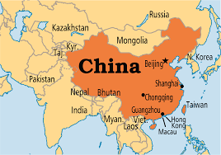
WHERE IS CHINA?
WHAT CONTINENT IS CHINA ON?
LOCATED IN ASIA
is THE LARGEST COUNTRY
LARGER THAN THE U.S.A
WHERE IS aNCIENT CHINA located?
CHINESE River Valley & was built along the HUANG HE & cHANG jIANG RIVER.
WAS cHINA ISOLATED?:
iN THE BEGINNING THE CHINESE DIDN’T KNOW THERE WERE OTHER ANCIENT CIVILIZATIONS IN THE WORLD BECAUSE THEY WERE ISOLATED BY NATURAL BARRIERS.

Slide 3
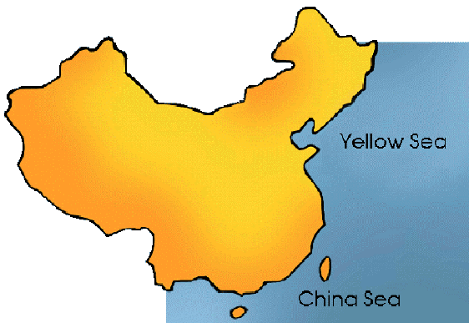
BODIES OF WATER IN CHINA
OCEANS AND SEAS:
CHINA SEA AND YELLOW SEA. PROVIDED FOOD AND WATER ROUTES FOR TRADE. BOTH SEAS ARE LOCATED IN THE PACIFIC OCEAN.
rIVERS:
CHINA’S RIVERS YANGTZE AND YELLOW, ARE ALL LOCATED TO THE EAST OF THE COUNTRY. tHEY PROVIDED FERTILE LAND & SAFE DRINKING WATER.

Slide 4
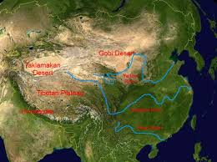
MOUNTAINS & DESERTS
Mountain Range:
CHINA is separated from INDIA by the Himalaya Mountain to the SOUTH & SOUTHwest.
dESERTS:
tHE gOBI AND TAKLIMAKAN DESERT ARE LOCATED TO THE WEST OF THE COUNTRY

Slide 5
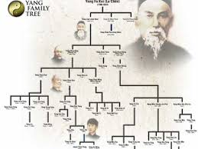
What is a DYNASTY?
The civilization of Ancient china dates back 1,000’s of years. over this time, china was ruled by different dynasties.
A dynasty is a series of rulers from the same family over time.
When a new family takes control a new dynasty begins.

Slide 6
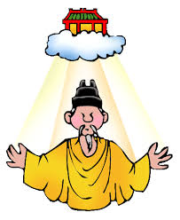
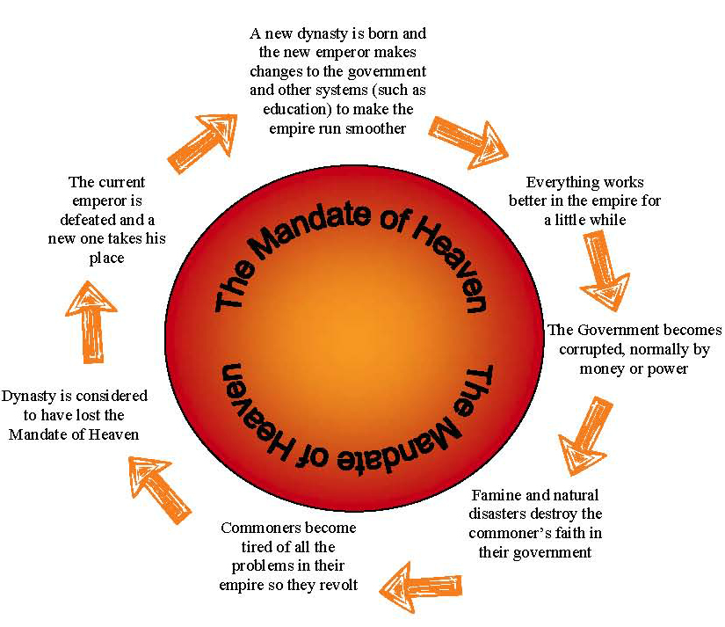
Mandate of Heaven
this is what the chinese believe gave the rulers the right to be king or emperor.
the gods have blessed that person with the right to rule.
The ruler must be good and fair in order to keep the Mandate of Heaven.
When the dynasty lost power, they lost the mandate of heaven.

Slide 7
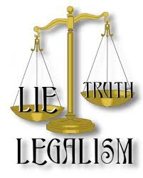
3 Philosophies of China
CONFUCIANISM
CREATED BY CONFUCIUS
LEGALISM
HAN FEIZI
TAOISM
CREATED BY LAO-TZU

Slide 8
CONFUCIANISM
CONFUCIUS SAW MANY PROBLEMS IN THE WORLD.
THE MOST IMPORTANT IDEAS WERE PEACE AND ORDER.
EVERYONE HAD A ROLE IN SOCIETY. IF THEY FULFILLED IT THEN THERE WOULD BE PEACE AND HARMONY
TO ESTABLISH ORDER HE CREATED AN OUTLINE OF HOW TO TREAT OTHERS.
MOST IMPORTANT RESPONSIBILITIES WERE FOR CHILDREN TO RESPECT AND LISTEN TO THEIR PARENTS & ELDERS.

Slide 9
DAOISM/TAOISM
lAOZI TAUGHT THAT A FORCE KNOWN AS THE DAO REPRESENTED ALL LIVING THINGS.
THE MOST IMPORTANT THING YOU CAN DO IT REJECT THE WORLD & THEIR DESIRES. SEEK WORLDLY POSSESSIONS, POWER, & NATURE.
MANY PEOPLE IN CHINA PRACTICE BOTH CONFUCIANISM AND DAOISM.
CONFUCIANISM TAUGHT THEM HOW TO BEHAVE TOWARDS ONE ANOTHER.
DAOISM TAUGHT THEM HOW TO BEHAVE TOWARDS THE NATURAL WORLD & WITHIN THEMSELVES PERSONALLY.

Slide 10
LEGALISM
LEGALIST BELIEVED THAT SOCIETY FUNCTIONED BEST THROUGH STRONG GOVERNMENT CONTROL
PEOPLE MUST BE OBEDIENT TO AUTHORITY
LAWS WERE CREATED THAT ORDER STRICT PUNISHMENTS & REWARDS FOR BEHAVIOR.
EMPEROR QIN SHI HUANGDI WORKED WITH LEGALIST TO BAN BOOKS ABOUT THE HISTORY OF CHINESE’S PAST RULERS AND IDEAS. BOOKS ABOUT CONFUCIUS WERE DESTROYED.
SCHOLARS WERE PUT TO DEATH BECAUSE OF THEIR BELIEFS OTHER THAN LEGALISM.

Slide 11
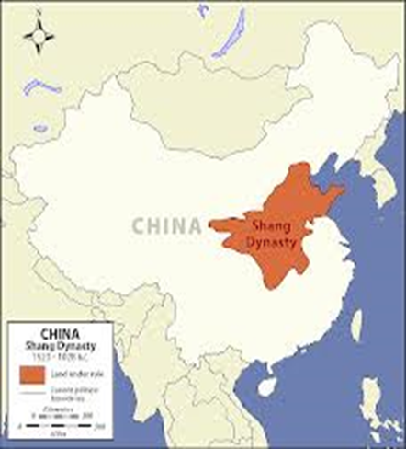
1ST DYNASTY: SHANG
Ruled the area along the Yellow River. The first civilization of Ancient China.
ACCOMPLISHMENTS OF THE SHANG:
Writing began
Used oracle bones to predict the future
Developed bronze
Glazed pottery
Silk

Slide 12
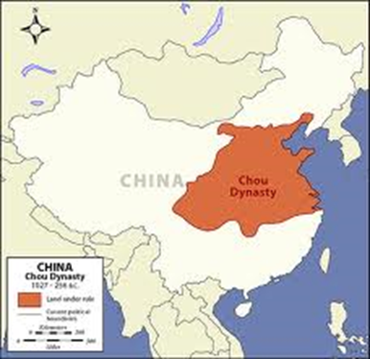
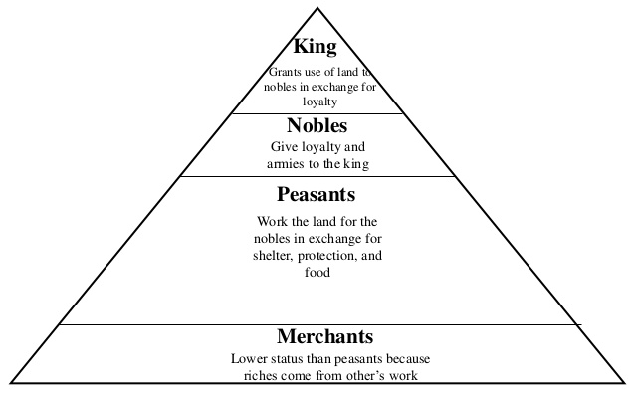
2ND DYNASTY: ZHOU
The longest ruling dynasty in the history of China.
First dynasty to use the Mandate of Heaven
Land was ruled by feudal lords who were relatives of the Zhou family.

Slide 13
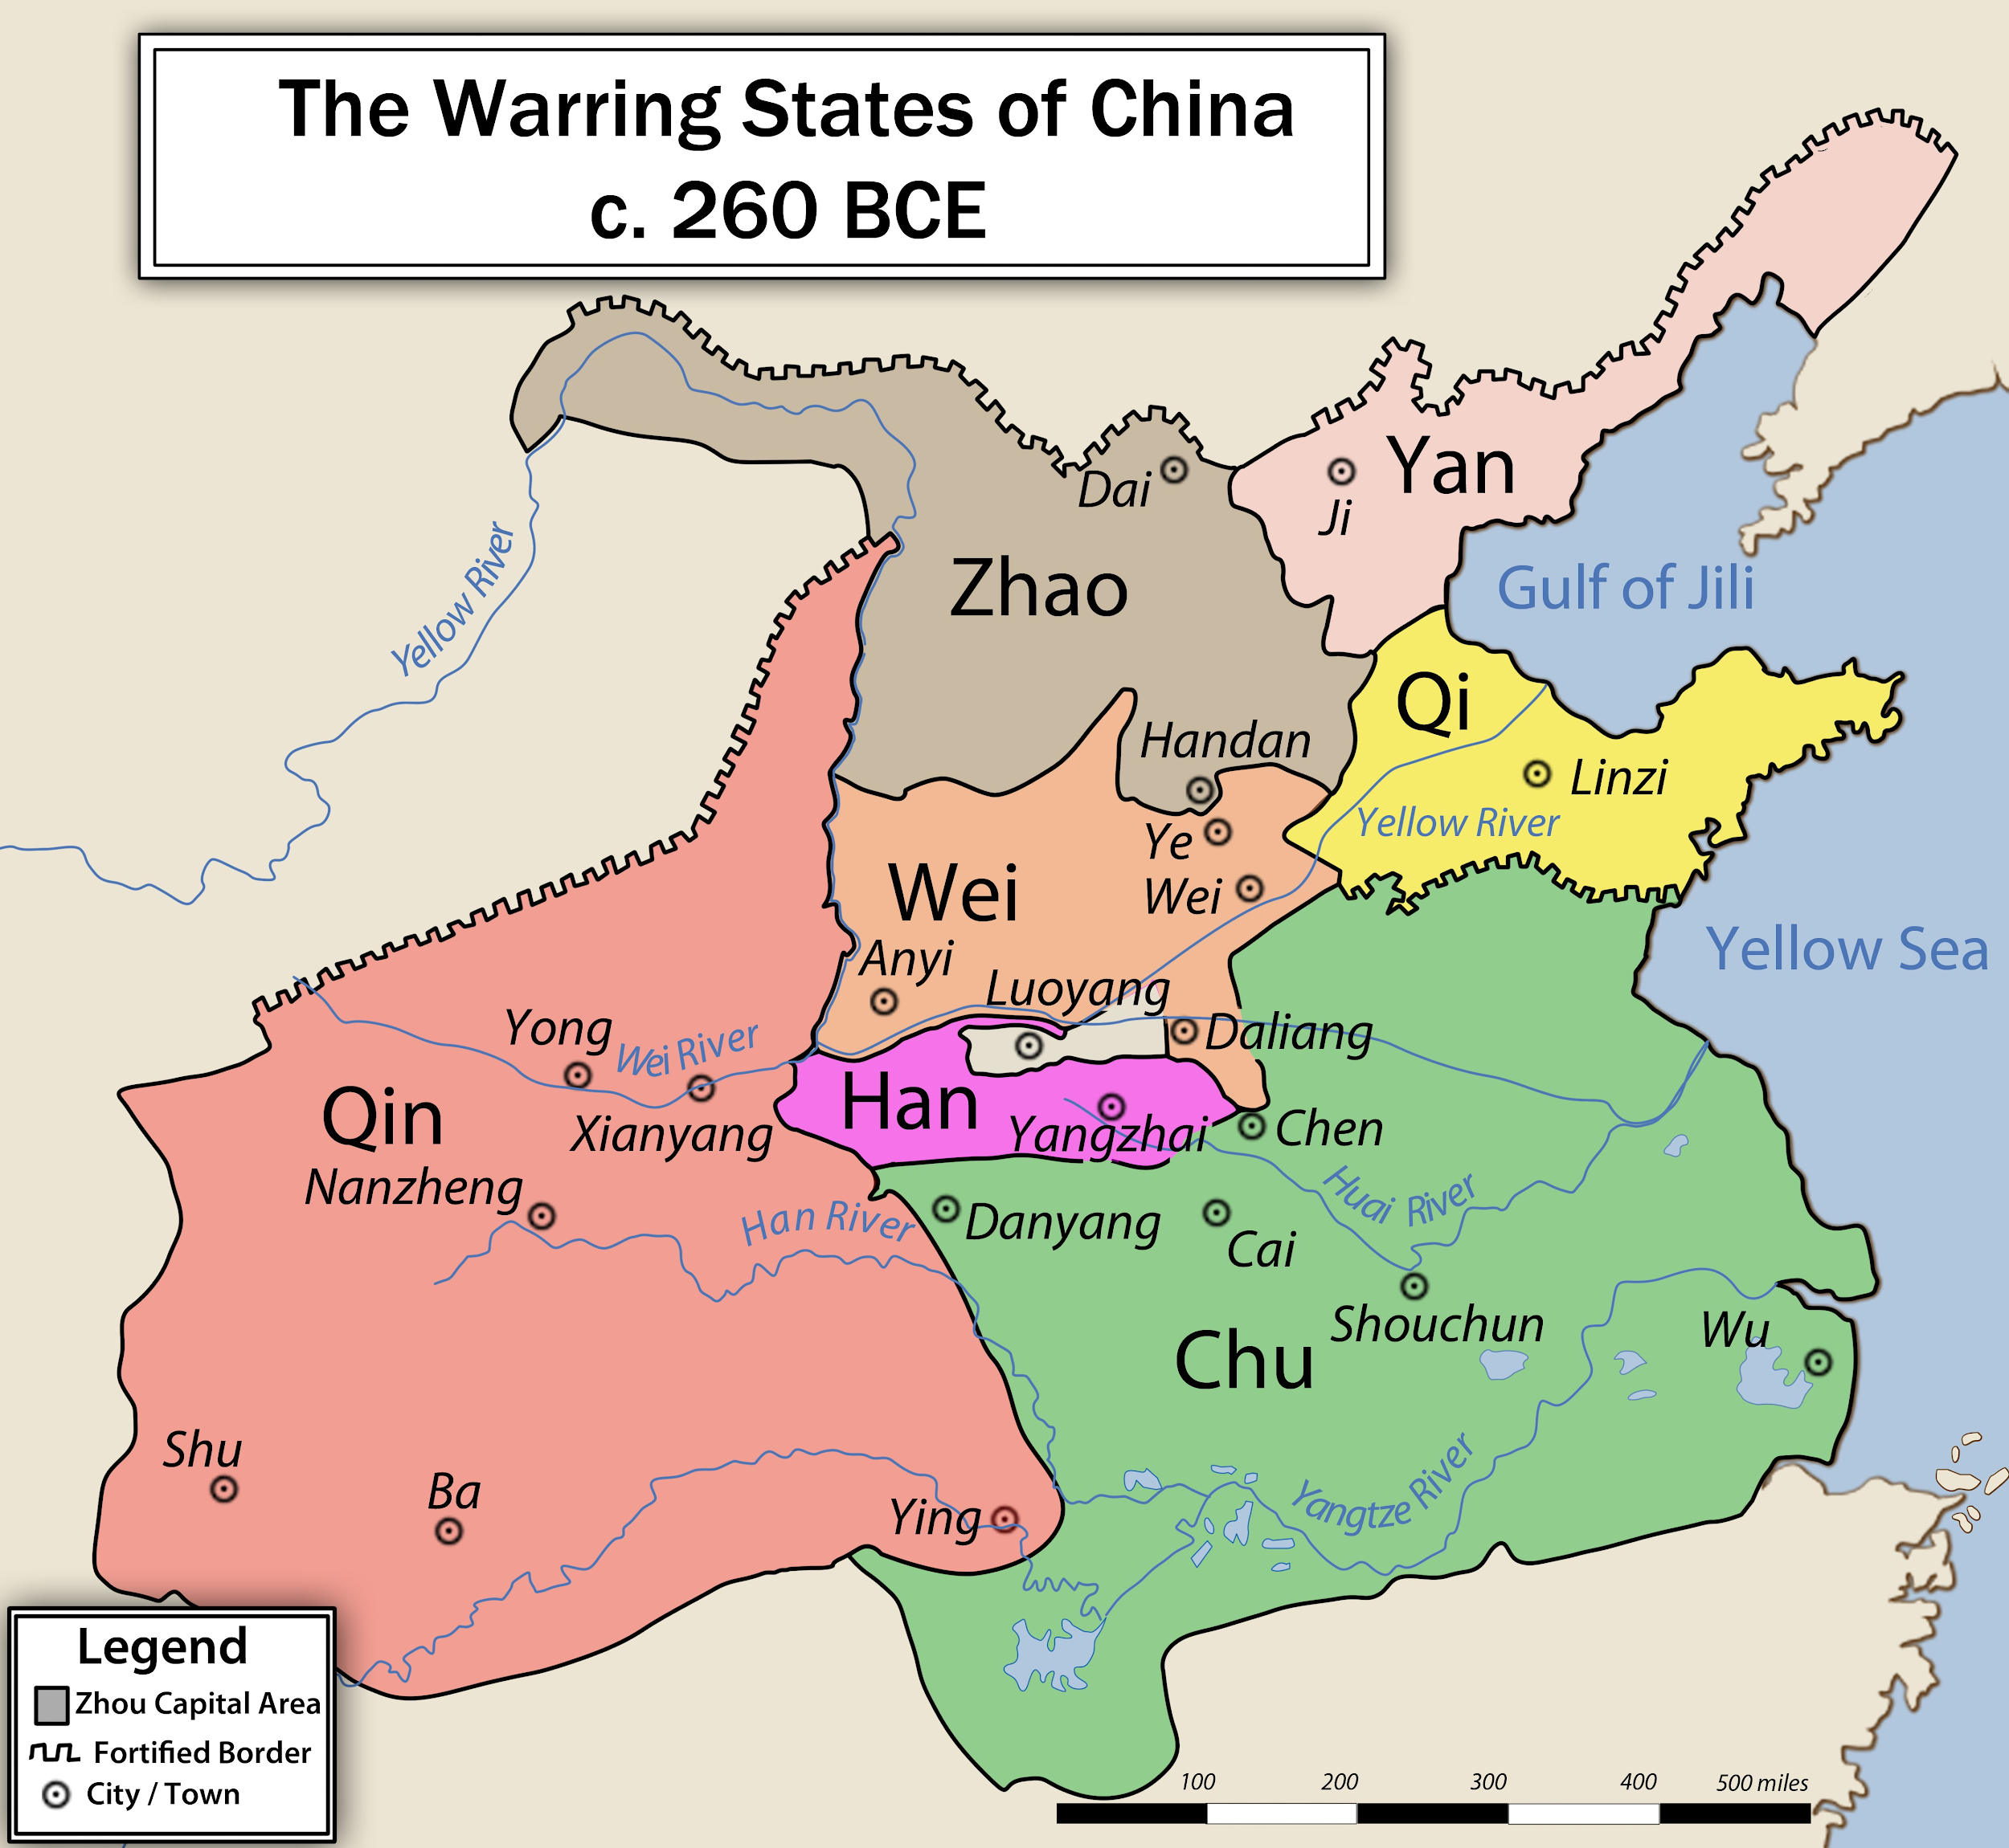
WARRING STATES
After the Zhou dynasty fell everything became chaotic.
For 250 years these 8 states battled for control over who would rule China.
The states were created during the Zhou dynasty to help govern the large amount of land.
The wars ended when the Qin state conquered them all.

Slide 14
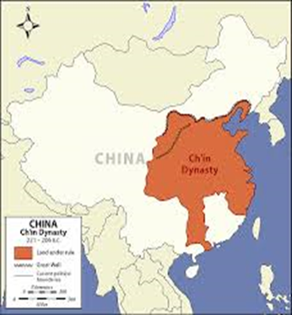
3RD dYNASTY: QIN
Emperor Shi Huangdi becomes the first emperor of China.
He unified [brought together] China after the time period of the Warring States.
He changed the way China was ruled:
He followed the philosophy of Legalism→ strict law with harsh punishments
Established a military dictatorship.
Destroyed the Nobles feudal power
Created taxes

Slide 15
3RD dYNASTY: QIN
These advancements would be used in future dynasties to make China strong.
The dynasty didn’t last long, but there were many accomplishments:
The Great Wall
Standardardized money
Roads and canals were built
Standardized writing & language
Terra Cotta Army
Multiplication Table

Slide 16
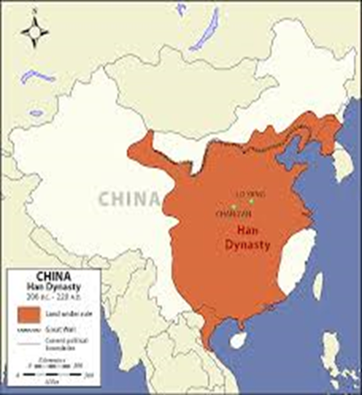
4th DYNASTY: HAN
CREATED THE SILK ROAD TO TRADE GOODS FROM CHINA TO ROME [EUROPE]
ACCOMPLISHMENTS OF HAN DYNASTY
Created a civil service exam to create a strong and organized government.
Paper and porcelain were also invented during this time.
Followed the philosophy of Confucianism
Poetry and literature
Compass
Seismograph
Silk

